Slide 1
Contra Costa County Mock Trial Award Ceremony 2021 #cocomocktrial
Welcome
Notes:
MW
Welcome. What an amazing and exciting 2021 Mock Trial competition...

Slide 2
Thank you, volunteers!
Notes:
MW
60 attorneys, LA, San Diego, Truckee, Olympia, Washington. Sitting judges retired attorneys, current District Attorney
*mention Carla Garret *

Slide 3
Welcome from Contra Costa County Superintendent of Schools Lynn Mackey
Notes:
LM

Slide 4
Welcome from the Contra Costa County Presiding Judge Rebecca Hardie
Notes:
LM

Slide 5
Coaches’ Awards
Notes:
MW
Each year, we offer our coaches a chance to create 5 awards for their students – we would like the coaches of the teams that chose to participate to announce their award recipients. Since we have quite a few awards, please try to limit your kudos to under 30 seconds:

Slide 6
Judges’ Choice Honorable Mention
School | Name
Alhambra | Dylan | Wen
Alhambra | Melanie | Jones
Alhambra | Nivia | Buttar
California | Cindy | Zhu
Campolindo | Maia | West
Campolindo | Samantha | Herzig
Carondelet | Alli | Lowe
Carondelet | Chloe | De Smedt
School | Name
Carondelet​ | Grace​ | Baer​
Carondelet​ | Nicole​ | Abudayeh​
De Anza​ | Elena​ | Martinez​
De Anza​ | Luz​ | Limon​
Deer Valley​ | Dennis | Gavrilenko​
Deer Valley​ | Daniel​ | Gober
Dougherty​ | Gayathri​ | Viswanath​
Dougherty​ | Katherine​ | Shi​
Dougherty​ | Nidhi​ | Thati​
Notes:
JL

Slide 7
Judges’ Choice Honorable Mention
School | Name
El Cerrito​ | Bennett​ | Yarnell​
El Cerrito​ | Luke​ | Thilmony
El Cerrito​ | Reese​ | Roberts​
El Cerrito​ | Riley​ | Parks​
El Cerrito | Sabra​​ | Chee​​
Heritage​ | Analise​ | Kingsmith​
Heritage​ | Tomieyah​ | Patterson​
School | Name
Kenn/Rich​ | John​ | Olivarez​
Kenn/Rich​​ | Tamara​​ | Flores​​
Las Lomas​​ | Asher​​ | Berlin​​
Miramonte​​ | Evy​​ | LaVelle
Miramonte​​ | Preston​​ | Nibley​​
Monte Vista​​ | Danial | Akhavan
Monte Vista​​ | Yik​​ | Seun Lung​​
Notes:
JL

Slide 8
Judges’ Choice Award Winners (with 2 votes each)
School | Name
Acalanes | Jamie | Lattin
Acalanes | Megan | Baginski
Alhambra | Kathar | Al-Janabi
California | Evelyn | Lee
Campolindo | Danielle | Whisnant
De Anza | Irene | Kou
De La Salle | Lance | Distefano
Notes:
JL-AND now for our Judges’ Choice Winners

Slide 9
Judges’ Choice Award Winners (with 2 votes each)
School | Name
De La Salle | Sean | Nimr
Deer Valley | Emma | Crandell
Hercules | Emma | Broward
Hercules | Navi | Emiliano
Heritage | Kenzie | Huether
Las Lomas | Dina | Mirmotalebisohi
Miramonte | Sarah | Svahn
Monte Vista | Sydney | Ellis
Notes:
JL-AND now for our Judges’ Choice Winners

Slide 10
Outstanding Journalist
Name | School
California | Nicholas Harvey
You can read the winning article on the Mock Trial results webpage following the awards ceremony.
Notes:
JY--It is time for outstanding individual awards next…starting with our Artist and Journalist awards… congratulations!! These two students will move on to the state level! Good luck!

Slide 11
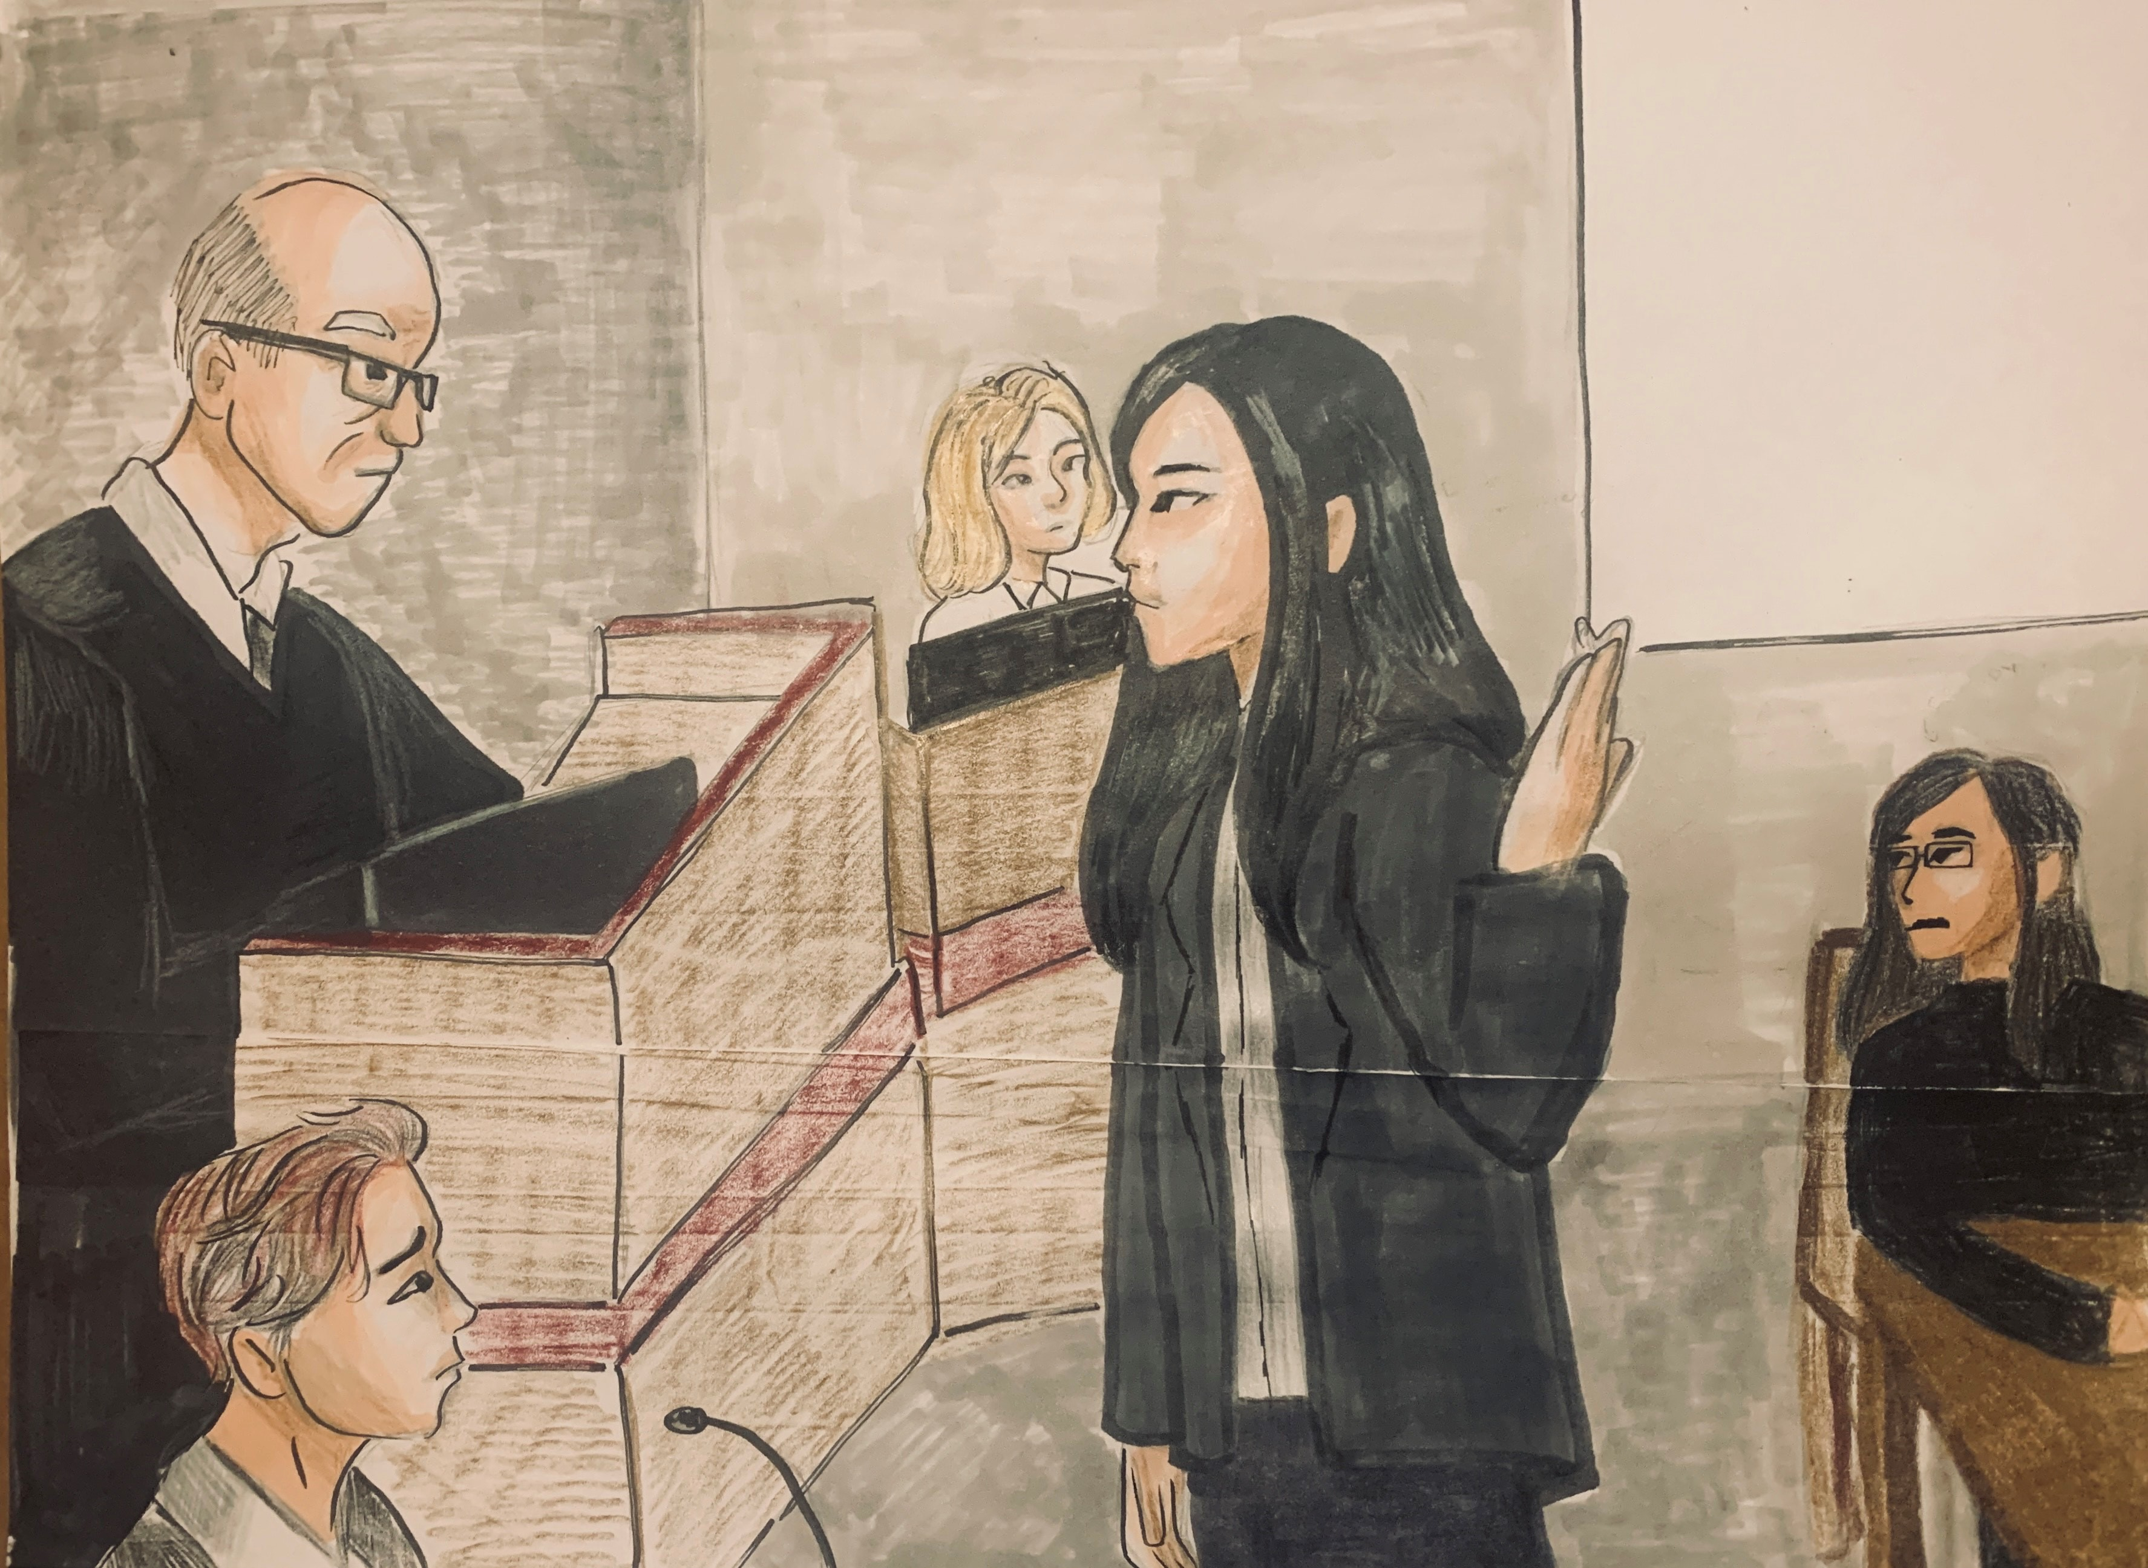
Outstanding Artist
Name | School
California | Michelle Nguyen

Slide 12
Outstanding Bailiff
School | Name | Score
Acalanes | Jamie Lattin | 5
Kennedy/Richmond | Tamara Flores | 5
Campolindo | Claire Damiano | 5
Heritage | Jayden Ervin | 5
Las Lomas | Dina Mirmotalebisohi | 5
Heritage | Jacqueline Fortner | 5
Notes:
MK

Slide 13
Outstanding Clerk
School | Name​ | Score
California | Aarav Manjunath​ | 5
Dougherty | Sarah Han​ | 5
Las Lomas | Mark Deng​ | 5
Carondelet | Alli Lowe​ | 5
Heritage | Kasey Aguinaga​ | 4.8
De Anza | Haya Garcia​ | 4.8
Alhambra | Andrea Maldonado-Rojas​ | 4.8
Deer Valley | Michael Todd​ | 4.8
Notes:
MK

Slide 14
Outstanding Prosecution Witness Remy Montoya
School | Name | Score
California | Brady Horton | 9.6
Alhambra | Kylee Sciara | 9.6
Campolindo | Tamar Weiss | 9.5
Notes:
JL

Slide 15
Outstanding Prosecution Witness Remy Montoya Honorable Mention
School | Name | Score
El Cerrito | Meghan Makthepharack | 9.4
Hercules | Carolyn Richardson | 9.1
Deer Valley | Sam Fishel | 9.1
Notes:
JL

Slide 16
Outstanding Prosecution Witness Drew Marshak
School | Name | Score
Alhambra | Victoria Gilbert | 9.5
De La Salle | Patrick George | 9.3
Dougherty | Prerita Babarjung | 9
El Cerrito | Benji Dutta | 9
Deer Valley | Sarina Turnage | 9
Notes:
JL

Slide 17
Outstanding Prosecution Witness Max Bird
School | Name | Score
El Cerrito | Meghan Maktheparack | 9.6
California | Cade Llewellyn | 9.5
Alhambra | Kyla Menconi | 9.5
Notes:
JL

Slide 18
Outstanding Prosecution Witness Max Bird Honorable Mention
School | Name | Score
Kenn/Richmond | Yael Guiterrez | 9
Deer Valley | Angelo Guiterrez | 9
De La Salle | Michael Giorgi | 9
Notes:
JL

Slide 19
Outstanding Prosecution Witness Kai Chavez
School | Name | Score
California | Diana Castaneda | 9.5
Alhambra | Gracie Penman | 9.5
De La Salle | Ben Deviney | 9.5
Carondelet | Paige Collier | 9.5
Miramonte | Vivienne Arndt | 9.2
El Cerrito | Jeanilinne Cruz | 9.2
Notes:
JL

Slide 20
Outstanding Defense Witness Lee Croddy
School | Name | Score
Acalanes | Jou Yoshida | 9.57
Campolindo | Shannon Crosby | 9.5
Alhambra | Kaelyn Nguyen | 9.4
Notes:
JY

Slide 21
Outstanding Defense Witness Lee Croddy Honorable Mention
School | Name | Score
Dougherty | Rani Vakhari | 9.3
De La Salle | Gabe Tang | 9.1
Hercules | Abner Gabriel Lumabas | 9.1
Notes:
JY

Slide 22
Outstanding Defense Witness Zuri O'Neill
School | Name | Score
Monte Vista | Derek Wong | 10
Acalanes | Helen O'Neal | 9.4
Campolindo | Michael Chu | 9.3
Miramonte | Allison Petek | 9.3
Notes:
JY

Slide 23
Outstanding Defense Witness Zuri O'Neill Honorable Mention
School | Name | Score
Kennedy/Richmond | Yolanda Flores-Navarette | 9.2
Notes:
JY

Slide 24
Outstanding Defense Witness Jes Beaart
School | Name | Score
Alhambra | Golnaz Ahmadieh | 9.2
Campolindo | Ellery Stankus | 9.1
Miramonte | Michelle Giovinazzo | 9.1
Notes:
JY

Slide 25
Outstanding Defense Witness Jes Beaart Honorable Mention
School | Name | Score
De Anza | Kiran Chuahan | 9
El Cerrito | Lucas Russell | 9
Dougherty | Varun Nirval | 9
Notes:
JY

Slide 26
Outstanding Defense Witness Erin Sullivan
School | Name | Score
Campolindo | Callen Bronson | 9.3
Miramonte | Daniella Resch | 9.1
Alhambra | Yara Hassan | 9
Acalanes | Mary Laska | 9
De La Salle | Tyler Laymon | 9
Kennedy/Richmond | Viridiana Ayala | 9
Notes:
JY

Slide 27
Outstanding Pre-Trial Motion: Prosecution
School | Name | Average Score
Alhambra | Brianna Hutchens | 29
Acalanes | Hanniel Dunn | 27.5
Campolindo | Kate Seater | 27
Miramonte | Preston Nibley | 27
Notes:
MK

Slide 28
Outstanding Pre-Trial Motion: Defense
School | Name | Score
Miramonte | Preston Nibley | 28
Acalanes | Jonas Buchel | 27.8
Deer Valley | Emma Crandell | 27.5
Campolindo | Isabelle Lurie | 27.5
El Cerrito | Simone Parisi | 27.5
Notes:
MK

Slide 29
Outstanding Opening Statement: Prosecution
Name | School | Score
Deer Valley | Caitlin Todd | 9.6
Monte Vista | Danyal Akhavan | 9.3
El Cerrito | Reese Roberts | 9.2
Notes:
MW

Slide 30
Outstanding Opening Statement: Prosecution Honorable Mention
School | Name | Score
Carondelet | Grace Baer | 9.16
Campolindo | Maia West | 9.14
Notes:
MW

Slide 31
Outstanding Opening Statement: Defense
School | Name | Score
Campolindo | Evonne Xu | 9.5
Miramonte | Mallika Dandamudi | 9.3
Dougherty | Nidhi Thati | 9.3
Notes:
MW

Slide 32
Outstanding Opening Statement: Defense Honorable Mention
School | Name | Score
Acalanes | Marisa Guerra Echevierra | 9.2
Monte Vista | Sydney Ellis | 9
Hercules | Benjamin Kim | 9
Notes:
MW

Slide 33
Outstanding Direct Exam Attorney: Prosecution
School | Name | Score
Carondelet | Grace Baer | 9.8
Alhambra | Dylan Wen | 9.67
El Cerrito | Reese Roberts | 9.6
Notes:
JL

Slide 34
Outstanding Direct Exam Attorney: Prosecution Honorable Mention
School | Name | Score
Hercules | Emma Broward | 9.5
Alhambra | Melanie Jones | 9.5
Notes:
JL

Slide 35
Outstanding Direct Exam Attorney: Defense
School | Name | Score
Acalanes | Megan Baginski | 9.42
Alhambra | Makayla Clauson | 9.4
Miramonte | Mallika Dandamudi | 9.3
Notes:
JL

Slide 36
Outstanding Direct Exam Attorney: Defense Honorable Mention
School | Name | Score
Monte Vista | Aileen Akhavan | 9.1
Campolindo | Danielle Whisnant | 9.1
Campolindo | Daniel Thaler | 9.1
Hercules | Navi Emiliano | 9.1
Notes:
JL

Slide 37
Outstanding Cross Exam Attorney: Prosecution
Name | School | Score
Carondelet | Alison Mendoza | 10
Campolindo | Maia West | 9.7
El Cerrito | Riley Parks | 9.6
Notes:
JY

Slide 38
Outstanding Cross Exam Attorney: Prosecution Honorable Mention
School | Name | Score
Alhambra | Melanie Jones | 9.5
Deer Valley | Caitlin Todd | 9.5
Carondelet | Nicole Abudayeh | 9.5
Notes:
JY

Slide 39
Outstanding Cross Exam Attorney: Defense
School | Name | Score
Campolindo | Danielle Whisnant | 9.8
Acalanes | Megan Baginski | 9.7
Miramonte | Evy Lavelle | 9.6
Notes:
JY

Slide 40
Outstanding Cross Exam Attorney: Defense Honorable Mention
School | Name | Score
Acalanes | Marisa Guerra Echevierra | 9.57
Campolindo | Daniel Thaler | 9.5
Hercules | Navi Emiliano | 9.5
Notes:
JY

Slide 41
Closing Argument Prosecution
School | Name | Score
Hercules | Emma Broward | 19.6
Acalanes | Jamie Lattin | 19.6
Carondelet | Nicole Abudayeh | 19.6
Notes:
MK

Slide 42
Closing Argument Prosecution Honorable Mention
School | Name | Score
De Anza | Irene Kou | 19
Alhambra | Dylan Wen | 19
Notes:
MK

Slide 43
Closing Argument Defense
School | Name | Score
Campolindo | Danielle Whisnant | 20
Hercules | Navi Emiliano | 19.6
Acalanes | Megan Baginski | 19.1
Notes:
MK

Slide 44
Closing Argument Defense Honorable Mention
School | Name | Score
Miramonte | Evy Lavelle | 19
El Cerrito | Zayn Murtaza | 19
Notes:
MK

Slide 45
AND NOW….
TOP OVERALL WINNING TEAMS for the
2021 Contra Costa County MOCK TRIAL:
Notes:
MW

Slide 46
4th place…
Hercules High School
Coach: Daphne Schrampf
Notes:
MW

Slide 47
3rd place…
Miramonte High School
Coach: Luke Ellis
Notes:
MW

Slide 48
2nd place…
Acalanes High School
Coach: Joseph Schottland
Notes:
MW

Slide 49
1st place…
California High School
Coach: Brian Barr
Notes:
MW

Slide 50
Contra Costa County Mock Trial Award Ceremony 2021 #cocomocktrial
Thank You!
Notes:
All

